Slide 1




A Complete Guide to Programming in C++
Chapter 10 - Functions

Slide 2
Functions
This chapter describes how to write functions of your own. Besides the basic rules, the following topics are discussed:
passing arguments
definition of inline functions
overloading functions and default arguments
the principle of recursion.

Slide 3

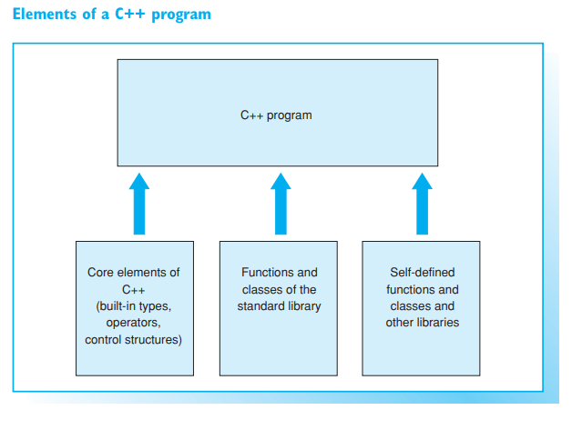

Significance of functions in C++
C++ supports efficient software development on the lines of the top-down principle. If you are looking to provide a solution for a more complex problem, it will help to divide the problem into smaller units. After identifying objects you will need to define classes that describe these objects. You can use available classes and functions to do so. In addition, you can make use of inheritance to create specialized classes without needing to change any existing classes.
When implementing a class you must define the capacities of those objects, that is, the member functions, in your program. However, not every function is a member function.
Functions can be defined globally, such as the function main() for example. Functions of this type do not belong to any particular class but normally represent algorithms of a more general nature, such as the search or sort functions of the standard library.

Slide 4
Libraries
You will not need to program each “building block” yourself. Many useful global functions and classes are available from the C++ standard library. In addition, you can use other libraries for special purposes. Often a compiler package will offer commercial class libraries or graphical user interfaces. Thus, a C++ program will be made up of
language elements of the C++ core
global functions and classes from the C++ standard library
functions and classes you have programmed yourself and other libraries.
Classes and functions that belong together are normally compounded to form separate source files, which can be compiled and tested independently. Using software components that you have already tested makes programming a complex solution much easier and improves the reliability of your programs. You can enhance the reusability of your source code by compiling your own libraries, but be sure to include comments for ease of readability.
Compiled source files, also known as modules, are compounded by the linker to an executable file by reference to the libraries you include. If you modify a source file, you may also need to recompile other files. In large scale projects it is recommended to use the MAKE utility for module management. An integrated developer environment will offer the functionality of this utility when you create a new project. This includes your own source files, the libraries used, and the compiler/linker settings for program compilation

Slide 5
Defining functions
Functions can be defined in any order, however, the first function is normally main. This makes the program easier to understand, since you start reading at the point where the program starts to execute.
EXAMPLE: Example of a function definition

Slide 6
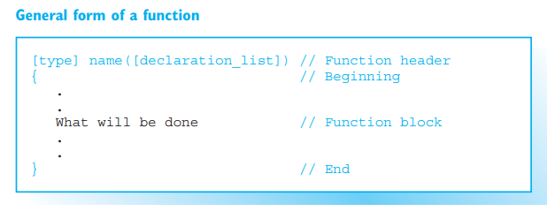
Defining functions
The function test() is shown in the EXAMPLE and followed by the general form of a function. The example can be read as follows:
type is the function type, that is, the type of the return value.
name is the function name, which is formed like a variable name and should indicate the purpose of the function.
declaration_list contains the names of the parameters and declares their types. The list can be empty, as for the function main(), for example. A list of declarations that contains only the word void is equivalent to an empty list.
The parameters declared in a list are no more than local variables. They are created when the function is called and initialized by the values of the arguments.
The left curved bracket indicates the start of a function block, which contains the statements defining what the function does.

Slide 7
Prototype and Definition
In a function definition the function header is similar in form to the prototype of a function. The only difference when a function is defined is that the name and declaration list are not followed by a semicolon but by a function code block.
The prototype is the declaration of the function and thus describes only the formal interface of that function. This means you can omit parameter names from the prototype, whereas compiling a function definition will produce machine code.

Slide 8
Return value of functions
EXAMPLE: A simple function returning a value.
The EXAMPLE shows how the function area() is defined and called. As previously mentioned, you must declare a function before calling it. The prototype provides the compiler with all the information it needs to perform the following actions when a function is called:
check the number and type of the arguments
correctly process the return value of the function.
A function declaration can be omitted only if the function is defined within the same source file immediately before it is called. Even though simple examples often define and call a function within a single source file, this tends to be an exception. Normally the compiler will not see a function definition as it is stored in a different source file.
When a function is called, an argument of the same type as the parameter must be passed to the function for each parameter. The arguments can be any kind of expressions, as the example opposite with the argument y+1 shows. The value of the expression is always copied to the corresponding parameter

Slide 9

Return Statement
When the program flow reaches a return statement or the end of a function code block, it branches back to the function that called it. If the function is any type other than void, the return statement will also cause the function to return a value to the function that called it.
If expression is supplied, the value of the expression will be the return value. If the type of this value does not correspond to the function type, the function type is converted, where possible. However, functions should always be written with the return value matching the function type.
The function area() makes use of the fact that the return statement can contain any expression. The return expression is normally placed in parentheses if it contains operators.
If the expression in the return statement, or the return statement itself, is missing, the return value of the function is undefined and the function type must be void. Functions of the void type, such as the standard function srand(), will perform an action but not return any value

Slide 10

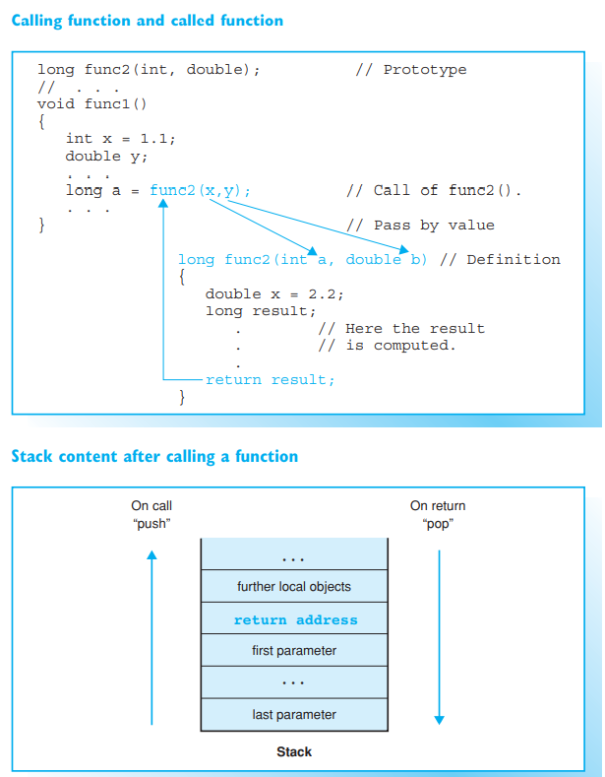
Passing arguments

Slide 11
Passing by Value
Passing values to a function when the function is called is referred to as passing by value. Of course the called function cannot change the values of the arguments in the calling function, as it uses copies of the arguments.
However, function arguments can also be passed by reference. In this case, the function is passed a reference to an object as an argument and can therefore access the object directly and modify it.
An example of passing by reference was provided in the example containing the function time(). When time(&sek); is called, the address of the variable sek is passed as an argument, allowing the function to store the result in the variable. We will see how to create functions of this type later.
Passing by value does, however, offer some important advantages:
function arguments can be any kind of expression, even constants, for example
the called function cannot cause accidental modifications of the arguments in the calling function
the parameters are available as suitable variables within the functions. Additional indirect memory access is unnecessary.
However, the fact that copying larger objects is difficult can be a major disadvantage, and for this reason vectors are passed by reference to their starting address.

Slide 12
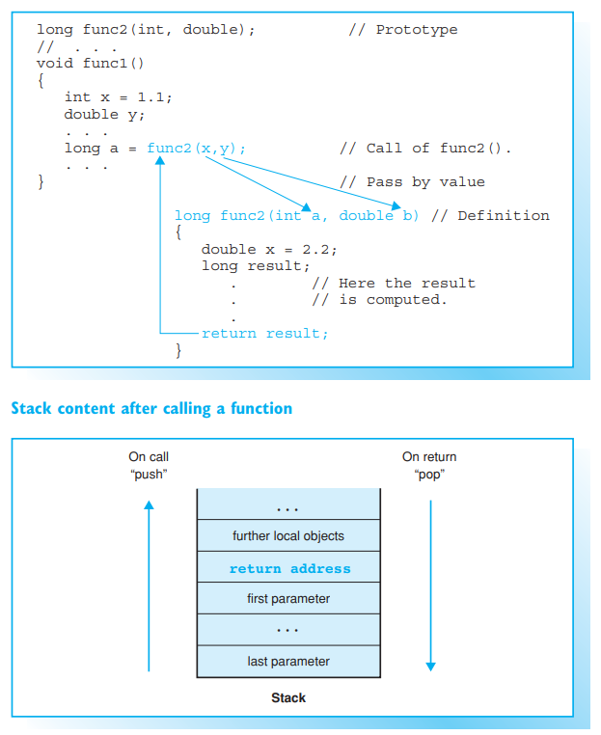
Local Objects
The scope of function parameters and the objects defined within a function applies only to the function block. That is, they are valid within the function only and not related to any objects or parameters of the same name in any other functions.
For example, the program structure opposite contains a variable a in the function func1() and in the function func2(). The variables do not collide because they reference different memory addresses. This also applies to the variables x in func1() and func2().
A function’s local objects are placed on the stack—the parameters of the function are placed first and in reverse order. The stack is an area of memory that is managed according to the LIFO (last in first out) principle. A stack of plates is a good analogy. The last plate you put on the stack has to be taken off first. The LIFO principle ensures that the last local object to be created is destroyed first.

Slide 13
Inline functions
When a function is called, the program jumps to a sub-routine, which is executed as follows:
the function parameters are placed on the stack and initialized with appropriate arguments
the so-called return address, that is, the place where the function was called, is stored on the stack and the program flow branches to the function
after executing the function the program uses the return address it stored previously to return to the calling function. The part of the stack occupied by the function is then released.
All this jumping back and forth can affect the run time of your program, especially if the function contains only a few instructions and is called quite often. The time taken to branch to a small function can be greater than the time needed to execute the function itself. However, you can define inline functions to avoid this problem.

Slide 14

Inline Definition
The compiler inserts the code of an inline function at the address where the function is called and thus avoids jumping to a sub-routine. The definition of an inline function is introduced by the inline keyword in the function header
The program code will expand each time an inline function is called. This is why inline functions should contain no more than one or two instructions. If an inline function contains too many instructions, the compiler may ignore the inline keyword and issue a warning.
An inline function must be defined in the source file in which it is called. You cannot simply supply a prototype of the function. The code containing the instructions must also be available to the compiler. It therefore makes sense to define inline functions in header files, in contrast to “normal” functions. This means the function will be available in several source files

Slide 15
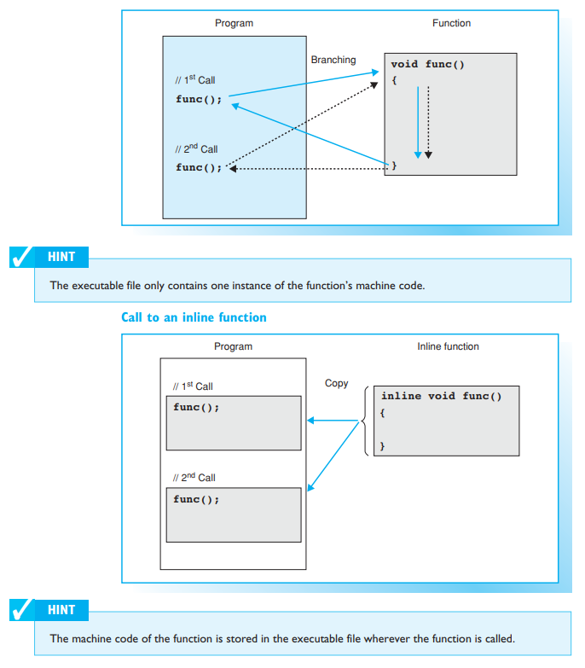
Inline Functions and Macros
Inline functions are an alternative to macros with parameters. When a macro is called, the preprocessor simply replaces a block of text. In contrast, an inline function behaves like a normal function, although the program flow is not interrupted by the function branching. The compiler performs a type check, for example

Slide 16
Default arguments
So-called default arguments can be defined for functions. This allows you to omit some arguments when calling the function. The compiler simply uses the default values for any missing arguments.
The default values of a function’s arguments must be known when the function is called. In other words, you need to supply them when you declare the function.

Slide 17


Defining Default Arguments
Parameter names can be omitted, as usual.
The function moveTo() can then be called with or without one or two arguments.
The first two calls are equivalent to moveTo(0,0); or moveTo(24,0); .

Slide 18
Defining Default Arguments
It is also possible to define default arguments for only some of the parameters. The following general rules apply:
the default arguments are defined in the function prototype. They can also be supplied when the function is defined, if the definition occurs in the same source file and before the function is called
if you define a default argument for a parameter, all following parameters must have default arguments
default arguments must not be redefined within the prototype scope (the next chapter gives more details on this topic).

Slide 19
Possible Calls
When calling a function with default arguments you should pay attention to the following points:
you must first supply any arguments that do not have default values
you can supply arguments to replace the defaults
if you omit an argument, you must also omit any following arguments. You can use default arguments to call a function with a different number of arguments without having to write a new version of the function.
EXAMPLE: Defining the function capital() and its possible calls

Slide 20

Overloading functions
Functions in traditional programming languages, such as C, which perform the same task but have different arguments, must have different names. To define a function that calculated the maximum value of two integers and two floating-point numbers, you would need to program two functions with different names.
Of course this is detrimental to efficient naming and the readability of your program— but luckily, this restriction does not apply to C++

Slide 21

Overloading
C++ allows you to overload functions, that is, different functions can have the same name.
In our example two different function share the same name, max. The function max() was overloaded for int and double types. The compiler uses a function’s signature to differentiate between overloaded functions.

Slide 22

Function Signatures
A function signature comprises the number and type of parameters. When a function is called, the compiler compares the arguments to the signature of the overloaded functions and simply calls the appropriate function.
In this case the double version of the function max() is called.

Slide 23


Function Signatures
When overloaded functions are called, implicit type conversion takes place. However, this can lead to ambiguities, which in turn cause a compiler error to be issued.
The signature does not contain the function type, since you cannot deduce the type by calling a function. It is therefore impossible to differentiate between overloaded functions by type.
Both functions have the same signature and cannot be overloaded

Slide 24
Recursive functions
A function that calls itself is said to be recursive. This process can also be performed indirectly if the function first calls another function or multiple functions before it is called once more. But a break criterion is always necessary to avoid having the function call itself infinitely.
The concept of local objects makes it possible to define recursive functions in C++. Recursion requires local objects to be created each time the function is called, and these objects must not have access to any other local objects from other function calls. What effectively happens is that the local objects are placed on the stack, and thus the object created last is destroyed first.

Slide 25
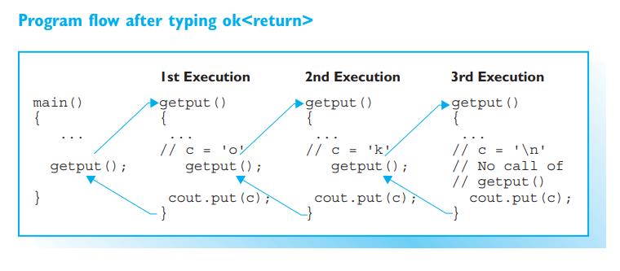
A Sample Program
EXAMPLE: Using a recursive function
Let’s look at the principle of recursion by referring to the EXAMPLE. The program contains the recursive function getput() that reads a line of text from the keyboard and outputs it in reverse order.
The function getput() is first called by main() and reads a character from the keyboard, storing it in the local variable c. If the character is not '\n', the function getput() calls itself again and thus reads a further character from the keyboard before storing it in the local variable c.
The chain of recursive function calls is terminated by the user pressing the Return key. The last character to be read, '\n' (line feed), is output and the program flow branches to the previous getput() instance. This outputs the second to last character, and so on. When the first character to have been read has finally been output, the program flow is handed back to main().

Slide 26
Practical Usage
The logic of various solutions to common problems results in a recursive structure, for example, browsing directory trees, using binary trees for data management, or some sorting algorithms, such as the quick sort algorithm. Recursive functions allow you to formulate this kind of logic in an efficient and elegant manner.
However, always make sure that sufficient memory is available for the stack.

